Slide 1


AGE 316:
MICROCOMPUTER SYSTEMS
LECTURE 11: LIBRARIES & FUNCTIONS
Dr. Kadeghe Fue
Department of Agricultural Engineering

Slide 2



Recap: Advanced Interfacing
Displays: We connected LCDs and OLEDs.
I2C Protocol: We saved pins using SDA/SCL.
Code: We used LiquidCrystal_I2C... but what is that?

Slide 3

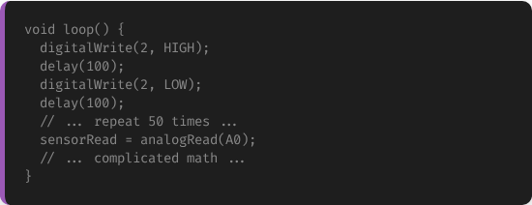
The "Spaghetti Code" Problem
Messy Code
As your projects grow, void loop() becomes huge.
•
Hard to read.
•
Hard to debug.
•
Copy-pasting the same code 10 times? Bad idea!

Slide 4

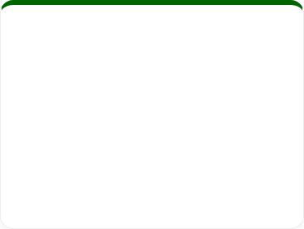





Solution: Functions
A Function is a named block of code that performs a specific task.
Encapsulate
Reuse
Organize
Wrap complex logic into a single named command.
Write once, call many times.
Keep your main loop clean and readable.

Slide 5

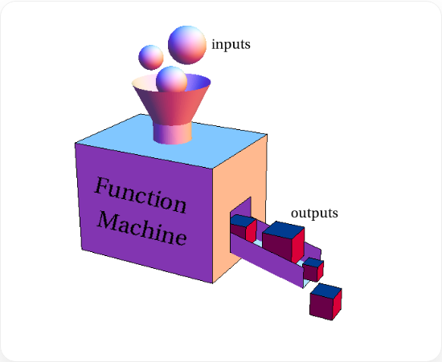
The "Function Machine"
Inputs & Outputs
Think of a function as a machine/factory.
1.
Input (Parameters): Raw materials (Numbers, Text).
2.
Processing (Body): The work happens inside the box.
3.
Output (Return): The finished product.

Slide 6





Anatomy of a Function
How to define a function in C++:
ReturnType: What comes out? (int, float, void).
Name: Descriptive action verb (e.g., blinkLED).
Parameters: Inputs needed (e.g., int pin).

Slide 7

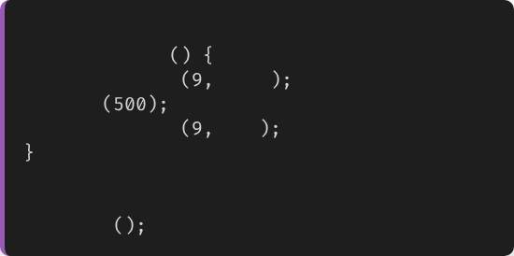
Type 1: Void Functions
"Doers"
// Definition
void
blinkRed
These functions do an action but give nothing back.
digitalWrite
HIGH
delay
digitalWrite
LOW
Keyword: void (Empty/Nothing).
Example: Turning on an LED, printing to Serial.
// Usage in loop
blinkRed

Slide 8

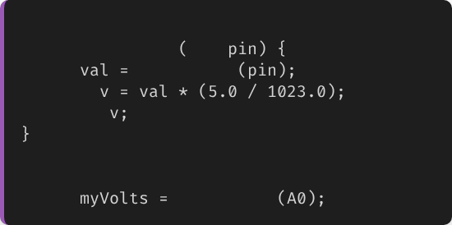
Type 2: Return Functions
"Calculators"
// Definition
float
getVoltage
int
These functions perform a calculation and send the result back.
int
analogRead
float
return
Keyword: return.
// Usage
Example: Converting Celsius to Fahrenheit.
float
getVoltage

Slide 9

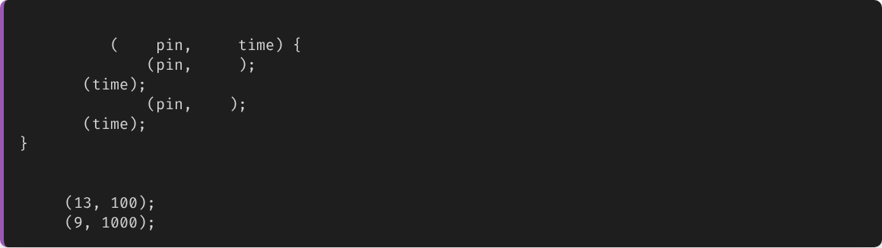
Parameters: Passing Data
Make your functions flexible by passing arguments.
// Flexible Blinker
void
blink
int
int
digitalWrite
HIGH
delay
digitalWrite
LOW
delay
// Call it with different data
blink
// Fast blink on 13
blink
// Slow blink on 9

Slide 10

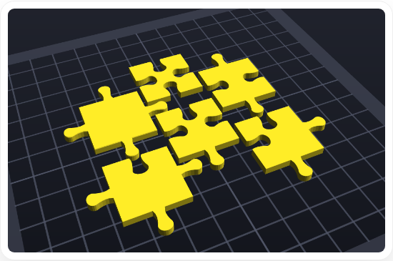
Moving Up: Libraries
"Don't Reinvent the Wheel"
A Library is a collection of functions written by someone else to solve common problems.
•
Controlling Servos? Servo.h
•
Driving LCDs? LiquidCrystal.h
•
Math? Math.h

Slide 11

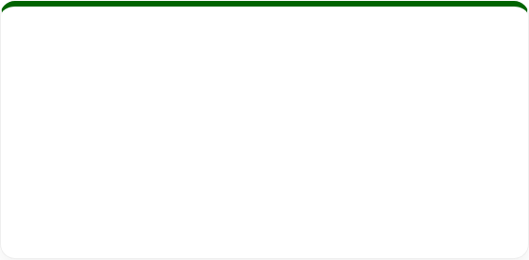
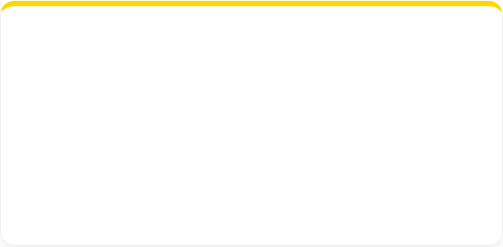
Anatomy of a Library
A library usually consists of two files:
.h (Header)
.cpp (Source)
The "Menu". Lists all the functions available for you to use.
The "Kitchen". Contains the actual code and logic (hidden from you).
You include them using: #include

Slide 12

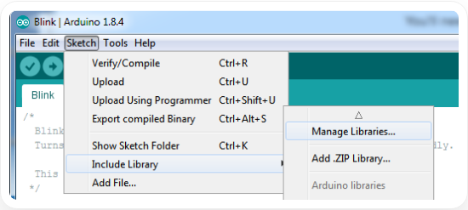
Installing Libraries
Library Manager
The easiest way. It's like an App Store for code.
1.
Sketch → Include Library → Manage Libraries.
2.
Search for the name.
3.
Click Install.

Slide 13

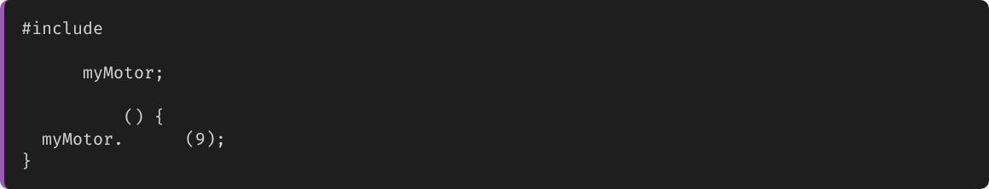
Using Libraries (Objects)
Most libraries require you to create an Object (Instance).
// 1. Include
Servo
// 2. Create Object
void
setup
attach
// 3. Use Object methods
Think of Servo as the blueprint, and myMotor as the actual robot you built.

Slide 14

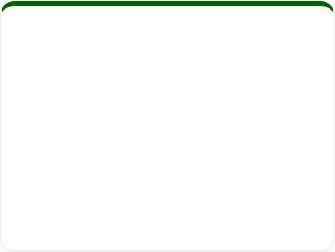
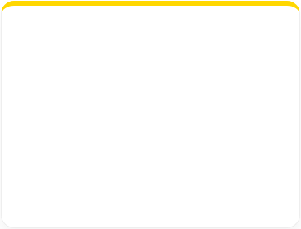




Engineering Ethics: Clean Code
Code is read by humans more often than by machines.
Naming
Small Functions
Comments
int x is bad.
int motorSpeed is good.
A function should do one thing only.
Explain Why, not just What.

Slide 15

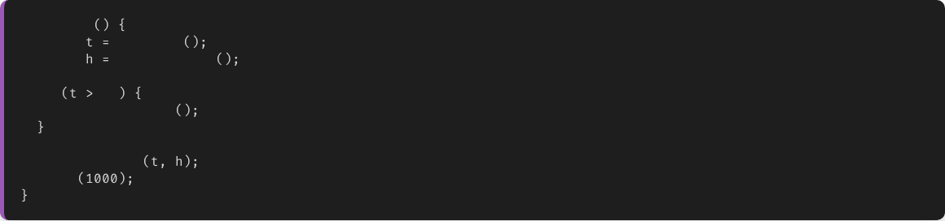
Practical: Modular Farm Monitor
void
loop
float
readTemp
float
readHumidity
if
30
activateCooling
updateDisplay
delay
Look how clean that loop is! All the complexity is hidden in functions.

Slide 16

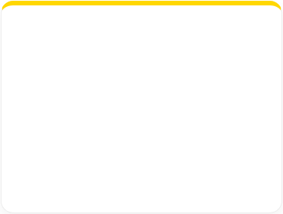




Summary
Functions
Libraries
Clean Code
Modular blocks of code. Use void or return types.
Pre-written code packages. Install via Library Manager.
Write code that is easy to read and maintain.

Slide 17


Questions?
"The only stupid question is the one you don't ask."
Dr. Kadeghe Fue
Sokoine University of Agriculture

Slide 18




Image Sources
https://mathinsight.org/media/image/image/function_machine.png
Source: mathinsight.org
https://fbi.cults3d.com/uploaders/40243519/illustration-file/1d4413fb-d86c-4e0a-9fef-67c0fca4da73/3532453453.png
Source: cults3d.com
https://cdn-learn.adafruit.com/assets/assets/000/063/403/medium800/learn_arduino_circuit_playground_libmanager.png?1539261525
Source: learn.adafruit.com

